Slide 1

ClueQuest.
Notes:
Hello and welcome to the presentation of our final project for Distributed Computing Class, which is a game called Clue Quest.

Slide 2

DISTRIBUTED GAME DEVELOPMENT.
SUPERVISED BY: Prof. Ramin Moazeni
AGENTS ASSIGNED:
SHRIVASTAVA, AJITA (ID: 016523104)
KARRI, SREE HARI (ID: 016421223)
KUEI, ANDY (ID: 013415467)
Document Dated: May 9, 2024
Notes:
I am Ajita and I along with Hari and Andy have worked on this project together.

Slide 3
INTRODUCTION.
The project:
Distributed Gaming Architecture
scalable, fault-tolerant system for real-world multiplayer gaming
tackles challenges of concurrency while maintaining performance within a dynamic, interactive environment.
Multiplayer Interaction with Clue Discovery
Scoring System based on timestamps
Notes:
"The project we chose is a multiplayer game based on Distributed Gaming Architecture built as a scalable, fault-tolerant system similar to real-world gaming experience.
tackles challenges of concurrency while maintaining performance within a dynamic, interactive environment.
Multiplayer Interaction with Clue Discovery
Scoring System based on timestamps

Slide 4



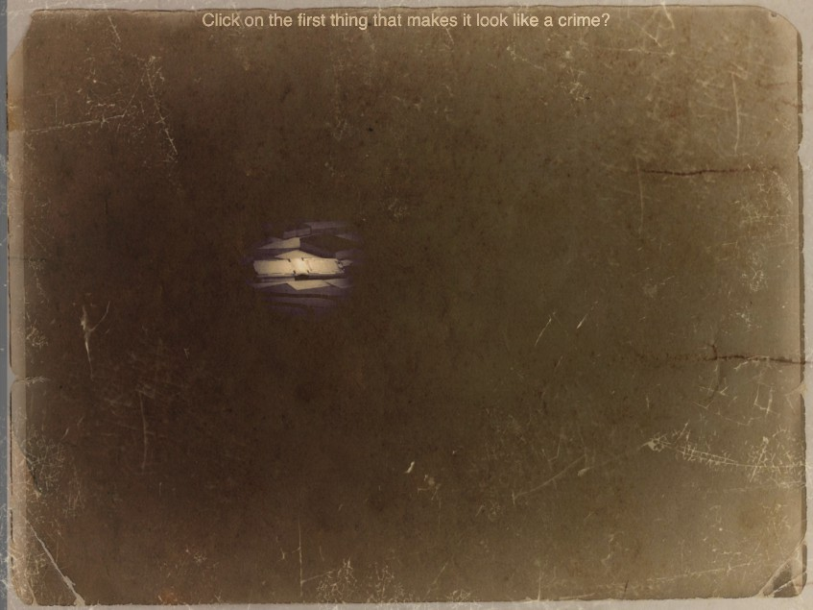

The Game.
An immersive game where players take the role of detectives
Tasked with unravelling mysteries while hunting for hidden treasures.
The player who successfully uncovers all the clues first emerges victorious.

Slide 5
Brief History.
1990s.-
Developers experimented with networked multiplayer games, initially relying on client-server architecture where game state and communication was managed by a central server.
The rise of MMOs in the 2000s, such as World of Warcraft and Eve Online, fueled advancements in distributed game development, leveraging intricate server clusters to accommodate thousands of players simultaneously within persistent virtual environments.
2000s.-
HTML5 and WebSocket technology propelled the popularity of browser-based multiplayer games (Eg: Agar.io and Slither.io) demonstrating the potential of distributed architectures for real-time, scalable gameplay accessible directly from web browsers.
2010s.-
Current.-
Advancements in cloud computing, containerization, and distributed systems empower developers to create highly scalable, fault-tolerant architectures for games like Slither.io, ensuring smooth gameplay experiences across multiple platforms.
Notes:
Early Experiments (1990s):
Distributed game development traces back to the 1990s when developers began experimenting with networked multiplayer games. Basic implementations relied on client-server architectures, where a central server managed game state and communication between players.
Proliferation of Massively Multiplayer Online Games (MMOs) (2000s):
The 2000s saw the rise of MMOs like World of Warcraft and Eve Online, driving advancements in distributed game development. These games utilized complex server clusters to support thousands of concurrent players in persistent virtual worlds.
Emergence of Browser-Based Multiplayer Games (2010s):
With the advent of HTML5 and WebSocket technology in the 2010s, browser-based multiplayer games gained popularity. Titles like Agar.io and Slither.io showcased the potential of distributed architectures for real-time, scalable gameplay experiences accessible directly from web browsers.
Advancements in Scalability and Performance (Present):
Modern distributed game development continues to evolve, with advancements in cloud computing, containerization, and distributed systems. Technologies like Docker, Kubernetes, and Apache ZooKeeper enable developers to build highly scalable, fault-tolerant architectures for games like Slither.io, supporting massive player bases and seamless gameplay experiences across diverse platforms.

Slide 6

KEY DESIGN CHOICES.
Leader Election
Broadcast using spanning tree
Timestamps
Peer Discovery

Slide 7
ARCHITECTURE.
Distributed network architecture
Harnesses peer-to-peer communication featuring leader election and mutual exclusion for fault tolerance.
Enables scalable gameplay by distributing workload, incorporating timestamps for game scores, and broadcasting intermediate and final results.
Built on Docker using ZooKeeper
Utilizes Docker containerization for efficient deployment and management of game components.
ZooKeeper is used to manage and synchronize the system, ensuring fault tolerance, consistency, and reliability across multiple nodes.
With python libraries: Kazoo and Flask
Kazoo streamlines communication with ZooKeeper, enabling leader election and mutual exclusion, ensuring smooth operation and reliability.
Flask integrates front-end services seamlessly, enhancing user experience and engagement with HTML and JavaScript.

Slide 8
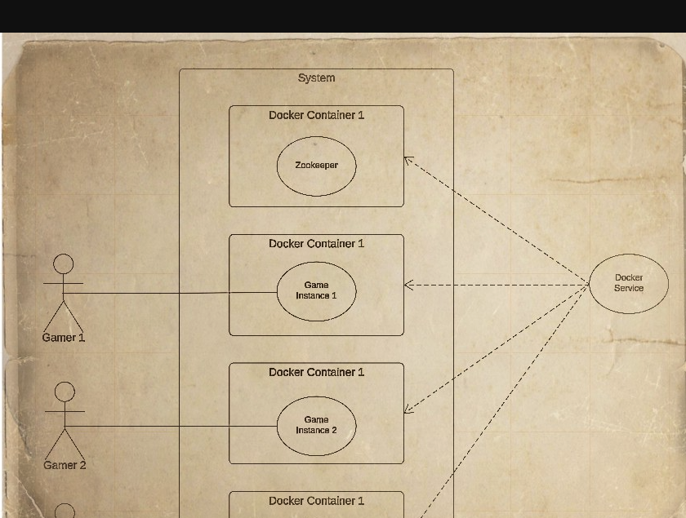
USE CASE.
This diagram provides a visual representation of:
User interaction
System components
Services used

Slide 9
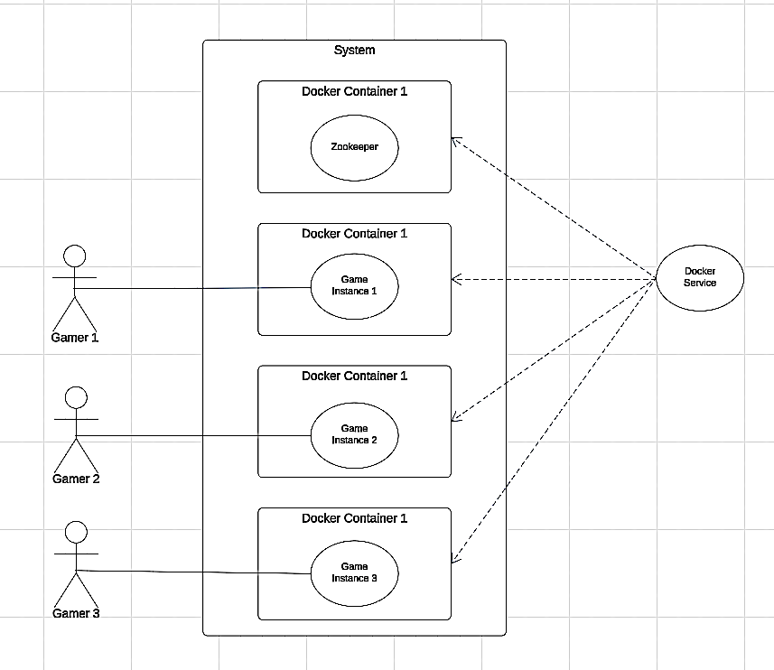

Slide 10
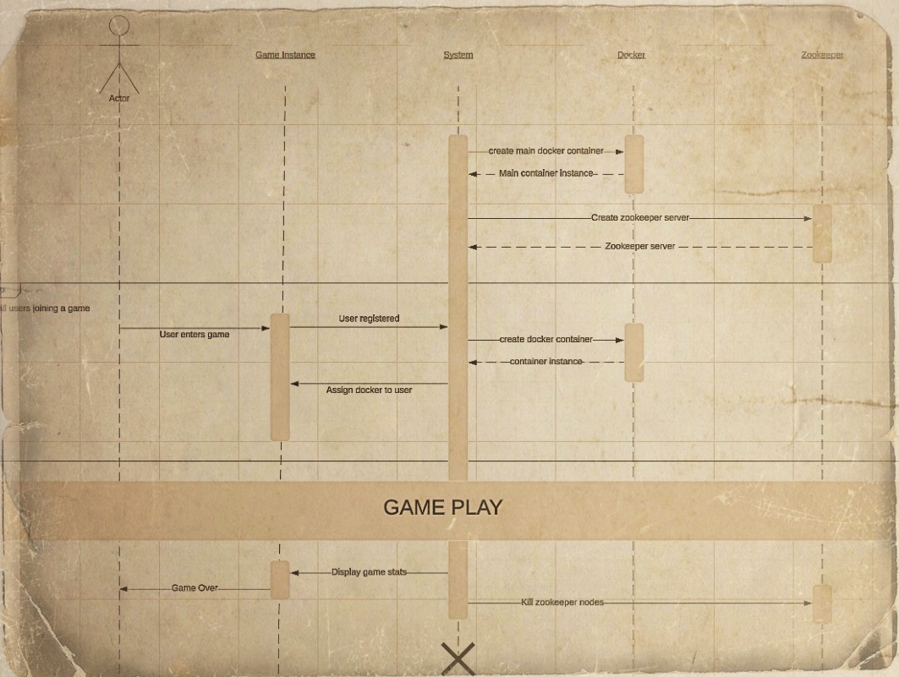
SEQUENCE.
This diagram depicts:
Component interaction
Over time
DevOps for the distributed gaming system.

Slide 11
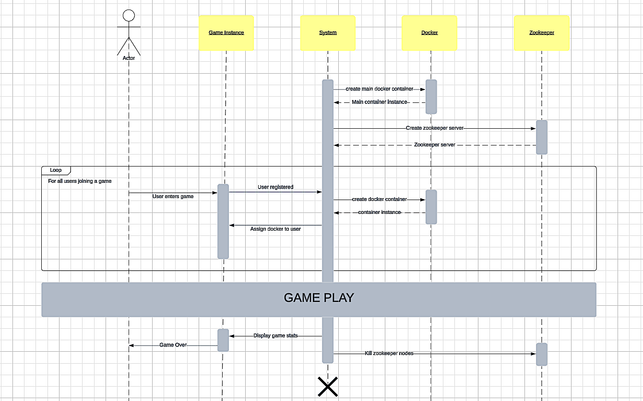

Slide 12
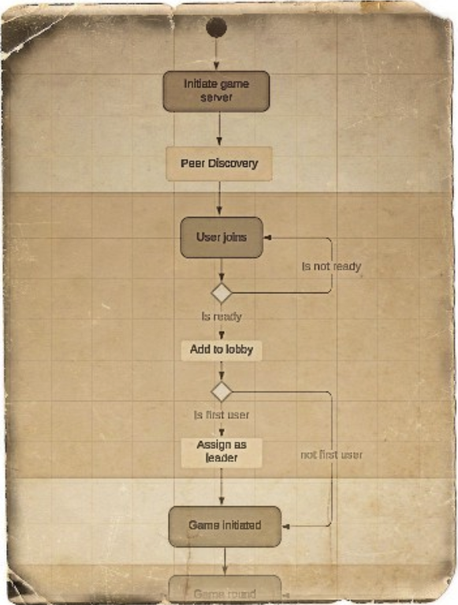
ACTIVITY.
This diagram depicts:
The game flow
Sequential vs parallel execution

Slide 13
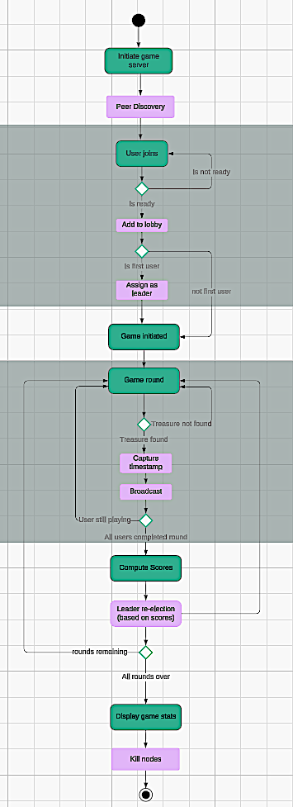

Slide 16
DEMONSTRATION

Slide 17
Game Evaluation
The Metrics.

Slide 18
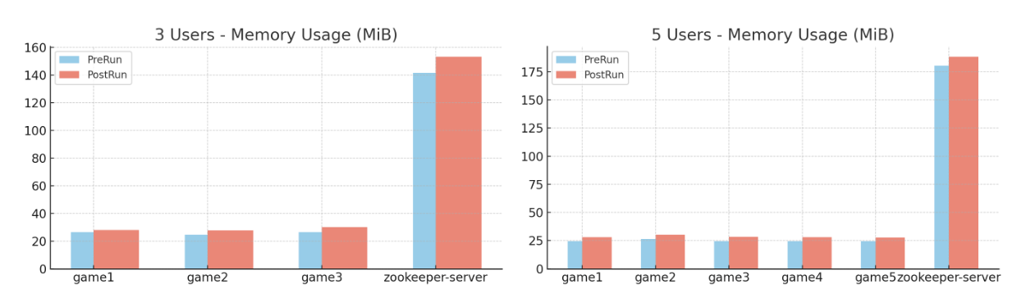
EVAL METRIC 1
The following graphs depict the relationship between the number of users and key metrics. Each graph illustrates how these metrics evolve as the user load increases.
Key performance metrics:
memory usage
network input/output
CPU usage.

Slide 20
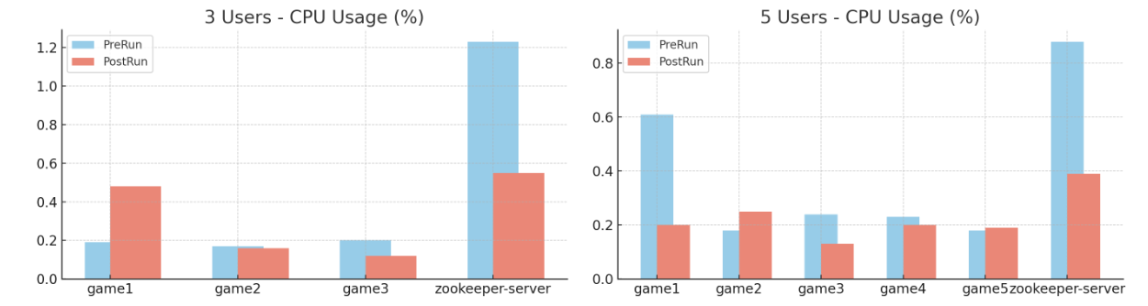

Slide 21
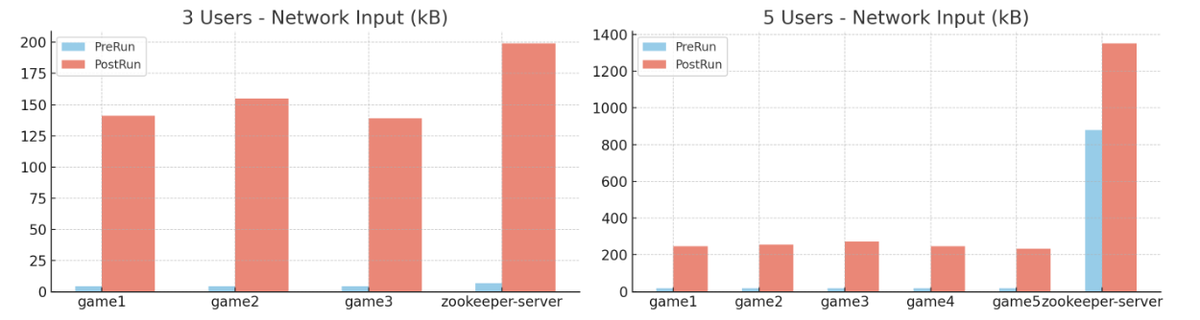

Slide 22
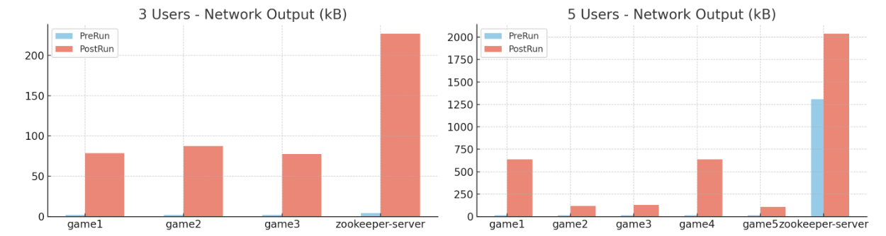

Slide 23
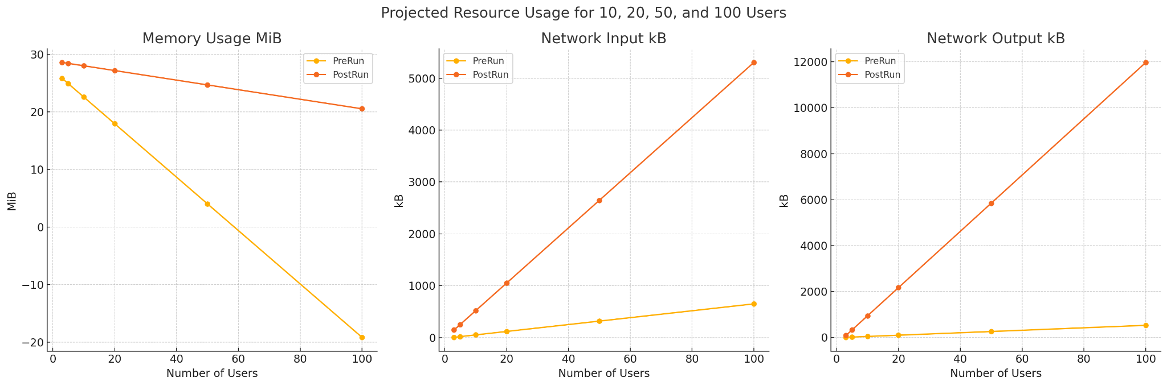
EVAL METRIC 2
Obtained data through testing with 3 and 5 users
Utilized linear regression with sklearn to extrapolate results for up to 100 users.
Highlights the system's scalability under varying user loads.
Notes:
We obtained data through testing with 3 and 5 users, then utilized linear regression with sklearn to extrapolate results for up to 100 users. As anticipated, the metrics exhibit growth corresponding to the increase in users, highlighting the system's scalability under varying user loads.
We obtained data through testing with 3 and 5 users, then utilized linear regression with sklearn to extrapolate results for up to 100 users. As anticipated, the metrics exhibit growth corresponding to the increase in users, highlighting the system's scalability under varying user loads.

Slide 25
CONCLUSION.
In conclusion, the Distributed Gaming Architecture project has successfully demonstrated its capabilities as a scalable and fault-tolerant system for real-world multiplayer gaming.
Addressing challenges of concurrency while maintaining optimal performance within a dynamic, interactive environment, the project has showcased its reliability and adaptability.
We evaluated it to be a good example of scalable distributed systems, validating its effectiveness in handling varying user loads.
The incorporation of features such as Multiplayer Interaction with Clue Discovery and a Scoring System based on timestamps has enhanced the gaming experience, providing players with engaging and immersive gameplay.
Moving forward, this project serves as a solid foundation for further advancements in distributed gaming architectures, promising seamless experiences for players worldwide.

Slide 26
THANK YOU!

Slide 27
CREDITS.
J. Donkervliet, J. Ron, J. Li, T. Iancu, C. L. Abad and A. Iosup, "Servo: Increasing the Scalability of Modifiable Virtual Environments Using Serverless Computing," 2023 IEEE 43rd International Conference on Distributed Computing Systems (ICDCS), Hong Kong, Hong Kong, 2023, pp. 829-840, doi: 10.1109/ICDCS57875.2023.00075.
K. Luo, T. Ouyang, Z. Zhou and X. Chen, "Behavior Tree-based Workflow Modeling and Scheduling for Serverless Edge Computing," 2023 IEEE 43rd International Conference on Distributed Computing Systems (ICDCS), Hong Kong, Hong Kong, 2023, pp. 955-956, doi: 10.1109/ICDCS57875.2023.00100.
M. Assiotis and V. Tzanov, “A Distributed Architecture for Massive Multiplayer Online Role-Playing Games,” 2005. Available: https://pdos.csail.mit.edu/archive/6.824-2005/reports/assiotis.pdf
M. Zamith et al., “A Distributed Architecture for Mobile Digital Games Based on Cloud Computing,” Nov. 2011, doi: https://doi.org/10.1109/sbgames.2011.13.
J. Lundgren, ‘Kubernetes for Game Development : Evaluation of the Container-Orchestration Software’, Dissertation, 2021.
K. Aning and K. L. Mannock, "An architecture and implementation of the actor model of concurrency," 2017 8th International Conference on Information, Intelligence, Systems & Applications (IISA), Larnaca, Cyprus, 2017, pp. 1-6, doi: 10.1109/IISA.2017.8316391.

